Slide 1



Fine-Tuning Generation Models
Chapter 12

Slide 2


Steps for fine tuning an LLM
The three steps of creating a high-quality LLM.

Slide 3
Instruction data
Instruction data with instructions by a user and corresponding answers. The instructions can contain many different tasks.
Notes:
During full fine-tuning, the model takes the input (instructions) and applies nexttoken prediction on the output (response). In turn, instead of generating new questions, it will follow instructions.

Slide 4
Adapter
Adapters add a small number of weights in certain places in the network that can be fine-tuned efficiently while leaving the majority of model weights frozen.
Notes:
Adapters are described in the paper “Parameter-efficient transfer learning for NLP”, which showed that fine-tuning 3.6% of the parameters of BERT for a task can
yield comparable performance to fine-tuning all the model’s weights.1 On the GLUE benchmark, the authors show they reach within 0.4% of the performance of full
fine-tuning.

Slide 5
Adapters for many tasks
Adapters that specialize in specific tasks can be swapped into the same architecture (if they share the same original model architecture and weights).
Notes:
The paper “AdapterHub: A framework for adapting transformers” introduced the Adapter Hub as a central repository for sharing adapters.2 A lot of these earlier adapters
were more focused on BERT architectures. More recently, the concept has been applied to text generation Transformers in papers like “LLaMA-Adapter: Efficient
fine-tuning of language models with zero-init attention”.

Slide 6
Matrx decompose for fine tuning
Decomposing a large weight matrix into two smaller matrices leads to a compressed, low-rank version of the matrix that can be fine-tuned more efficiently.

Slide 7
Small matrices
Compared to full fine-tuning, LoRA aims to update a small representation of the original weights during training.

Slide 8
Word-Level Metrics
Text-word prediction is a central feature of many LLMs.
Notes:
Of note is perplexity, which measures how well a language model predicts a text. Given input text, the model predicts how likely the next token is. With perplexity, we
assume a model performs better if it gives the next token a high probability. In other words, the models should not be “perplexed” when presented with a well-written
document.

Slide 9
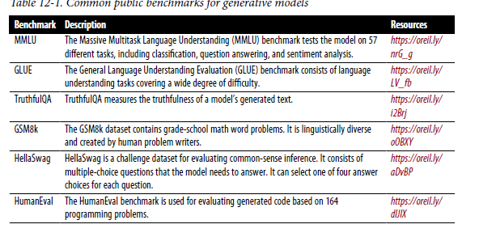
Benchmarks
Use cases for instruction-based prompting.

Slide 10
Reward model:
Use a reward model trained on human preference to generate the completion
quality score.
Notes:
The way we expect this reward model to work is that we give it a prompt and a generation, and it outputs a single number indicating the preference/quality of that generation in response to that prompt. Figure 12-26 shows the reward model generating this single number.

Slide 11










TYPES OF AI
NARROW AI
GENERAL AI
SUPER AI
Narrow AI is designed to perform a specific task
General AI can perform any intellectual task that a human can
Super AI is hypothetical and would surpass human intelligence

Slide 12





HISTORY OF AI
The Dartmouth Conference, where the term "artificial intelligence" was first coined and AI was established as a field of research.
1956
The first AI system that could understand and respond to natural language was created by Terry Winograd, which marked a major step forward in natural language processing.
1974
IBM's Deep Blue defeated the world chess champion Garry Kasparov, demonstrating that machines could surpass human intelligence in specific domains.
1997
The emergence of deep learning led to breakthroughs in computer vision, speech recognition, and natural language processing.
2012

Slide 13



IN FINANCE
75%
12,000
50%
people said that AI has improved their decision-making process.
Morgan Chase used AI to analyze 12,000 commercial loan agreements in seconds
The use of AI in fraud detection has led to a 50% reduction in false positives

Slide 14








IN MANUFACTURING
Item 2
Item 3
12
10
8
6
4
2
0
2015
2016
2017
2018
2019
2020
2021

Slide 15








IN TRANSPORTATION
REDUCE 20% FUEL CONSUMPTION
REDUCE 30% MAINTENANCE COSTS
Self-driving trucks powered by AI have been shown to reduce fuel consumption by up to 20%, saving companies thousands of dollars per year.
AI-powered predictive maintenance can reduce maintenance costs by up to 30%, and increase vehicle reliability and uptime.

Slide 16






03
SOCIAL IMPLICATIONS
Explores the broader impact of AI beyond specific industries or applications. Considers ethical and societal implications such as job displacement, bias, privacy concerns, and potential impacts on democracy and human rights. Encourages a critical and thoughtful approach to AI development and deployment, taking into account the potential risks and benefits to individuals and society as a whole.

Slide 17




AI AND JOBS
JOBS AT HIGH RISK
JOBS AT SIGNIFICANT RISK
14%
32%

Slide 18
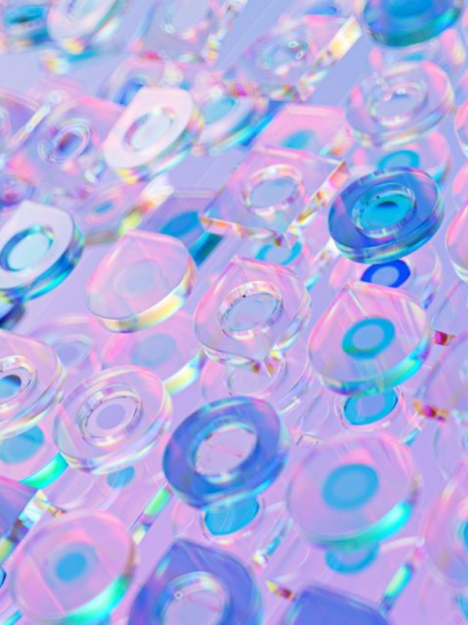


AI ETHICS
81%
People believe that companies should prioritize ethical considerations
63%
Were concerned about the ethical implications of the AI system

Slide 19
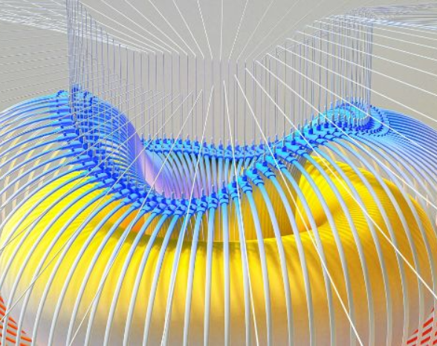

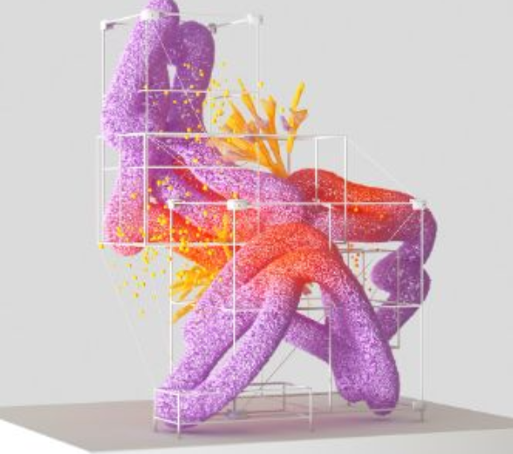

AI AND PRIVACY
A survey by Pew Research Center found that 64% of Americans are concerned about the way that companies are using their data, and 81% feel that they have little or no control over the data that companies collect about them.
20%
55%
The EU's GDPR includes provisions for ensuring that individuals have the right to access and control their personal data, including data that is processed using AI systems.

Slide 20



AI AND SOCIETY
Discusses the broader societal implications of AI, including its impact on job displacement, inequality, and social norms. This section aims to provide a comprehensive understanding of the ways in which AI is shaping our society and the challenges that need to be addressed.
04

Slide 21


THE RISE OF POWERFUL AI WILL BE EITHER THE BEST OR THE WORST THING EVER TO HAPPEN TO HUMANITY. WE DO NOT YET KNOW WHICH.
STEPHEN HAWKING

Slide 22








THANK YOU FOR
CHOOSING EATEMP
We offer free and high-quality slides templates for your presentations. We appreciate you choosing us and hope our templates have been helpful.
As a new website, we rely on your support to grow, so please help us by sharing our site with your friends and colleagues.
eatemp._
@eatemp
eatempofficial
@eatemp.official

